Slide 1

Rezoning of Hazelwood Riverfront:
RIV-GI to RIV-IMU
City Councilmember Barb Warwick
Aug. 19, 2025

Slide 2
Legislation Language
2025-1993: Ordinance amending the Pittsburgh Code, Title Nine, Zoning Code, Article I, Introduction and Establishment, Section 902.03, Zoning Map, to rezone parcels 56-N-300, 56-N-410, 56-N-400, 56-J-325-0-3, 56-N-300-A, 57-F-100-A-1, 56-N-96, 56-N-97-A, 56-N-97, 56-N-98-A, 56-N-98-B, 56-N-98-C, 56-N-99, 56-N-99-B, 56-N-95, 56-N-52, 56-N-93, 56-N-91, 56-N-90, 56-N-88, 57-A-8, 57-B-300, 57-B-350, 30-M-100, 57-F-50-A-1, 57-F-2, 57-F-100-A-1, 57-G-425, 30-M-100, 57-H-150-A-1, 57-H-200-A, 90-E-10-0-1, 90-E-50-A, 89-L-100-A, 57-S-50, 57-S-100, 57-S-30, 57-S-89, 57-S-92, 57-S-60, 57-S-60-0-2, 57-S-40, 57-S-6, 57-S-12, 92-D-60, 92-D-50, 92-D-300-9, 92-D-10-1, and 92-D-20 from the RIV-GI (Riverfront General Industrial Subdistrict) to RIV-IMU (Riverfront Industrial Mixed-Use Subdistrict) in the Hazelwood neighborhood of the 15th Ward, and in the 31st Ward.
Full legislation details with text:
https://pittsburgh.legistar.com/LegislationDetail.aspx?ID=7450275&GUID=B7828059-9C4A-40F9-9BD3-B3B25031EAA8&Options=ID|Text|&Search=Hazelwood

Slide 3
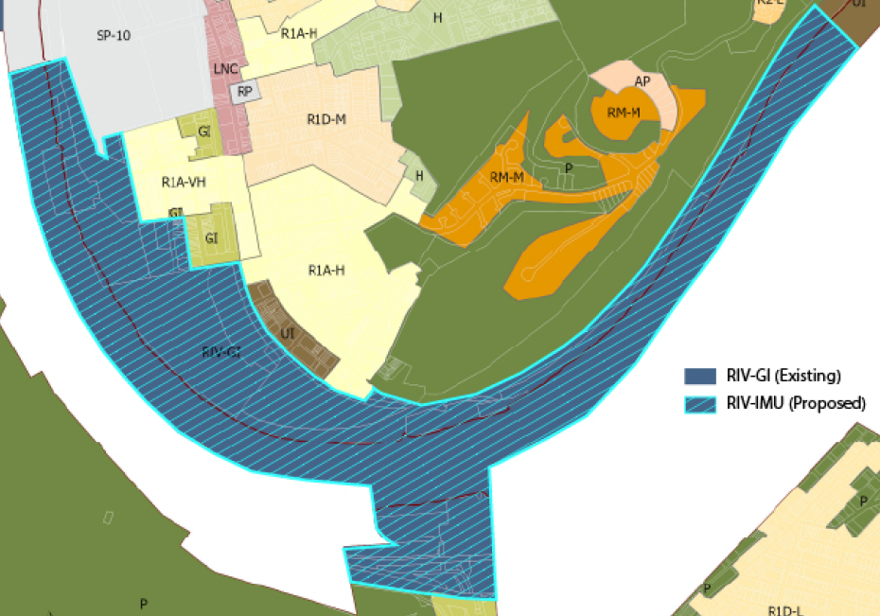
Map of Area for Proposed Rezoning

Slide 4
Zoning Uses Definitions
P = Permitted By Right – no approval needed
A = Administrator Exception – approval needed from Zoning Administrator
S = Special Exception – approval needed from the Zoning Board of Adjustment
C = Conditional Use – requires a vote by City Council

Slide 5
Uses in Riverfront General Industrial Subdistrict (RIV-GI)
Adult entertainment (S)
Agriculture General, Limited, and with Beekeeping (P)
Basic Industry (basic processing and manufacturing of materials or products predominantly from extracted or raw materials) (P)
Car Wash (P)
Communication Tower Class A (S), Class B C9S), Class C (C)
Construction Contractor Limited and General (P)
Controlled Substance Dispensary (C)
Correctional Facility Limited and General (C)
Excavation, Grading, Fill (C)
Firearms Business Establishment (S)
Freight Terminal (P)
Funeral Home (P)
Hazardous Operations (e.g. arsenals, atomic reactors, explosives and fireworks manufacture, hazardous waste disposal and storage, medical waste disposal and storage. And radioactive waste handling facilities.) (C)
Heliport (includes everything, fueling etc.) (C)
Incinerator, Solid Waste (C)
Laboratory/Research Services (P)
Laundry Services (P)
Manufacturing and Assembly (P)
Medical Marijuana Growing and Processing (P)
Office, Limited – less than 10,000 sq. ft. (P)
Outdoor Retail Sales and Service (A)
Parking, Commercial (A – <25 spaces, S – >25 spaces)
Parks and Recreation (P)
Recycling Collection Station (P)
Recycling Processing Center (P)
Safety Service Facility (P)
Salvage Yard (A)
Transit Facility (S)
Utility (P)
Vehicle/Equipment Repair (P)
Vehicle/Equipment Sales (P)
Vocational School (P)
Warehouse (P)
Welding or Machine Shop (P)

Slide 6
Uses in Riverfront Industrial Mixed-Use Subdistrict (RIV-IMU)
Two-, Three-, & Multi-Unit Residential (P)
Assisted Living (<18 – P, >18 – S)
Community Home (S)
Housing for the Elderly (<30 – A, >30 – S)
Multi-Suite Residential (<8 bedrooms – P, >8 bedrooms – A)
Personal Care Residence (19 people max – S, 8 people max – A)
Agriculture Limited, and with Beekeeping (P)
Amusement Arcade (S)
Animal Care (P)
Art or Music Studio (P)
Public Assembly (S)
Bank or Financial Institution (P)
Basic Industry (basic processing and manufacturing of materials or products predominantly from extracted or raw materials) (S)
Bed & Breakfast (P)
Car Wash (A)
Child Care (P)
Club (P)
College or University Campus (C)
Community Center (A)
Communication Tower Class A (S), Class B C9S), Class C (C)
Construction Contractor Limited (A)
Controlled Substance Dispensary (C)
Correctional Facility Limited (<50 beds) (C)
Cultural Service (P)
Custodial Care Facility (C)
Educational Classroom Space (P)
Excavation, Grading, Fill (C)
Firearms Business Establishment (S)
Freight Terminal (S)
Funeral Home (P)
Grocery Store (P)
Helipad (includes parking) (C)
Helistop (no parking) (S)
Hospital (S)
Hotel/Motel (P)
Laboratory/Research Services (P)
Laundry Services (S)
Library (P)
Manufacturing and Assembly (P)
Medical Marijuana Growing and Processing (P)
Medical Office/Clinic (P)
Nursery (P)
Office (P)
Outdoor Retail Sales and Service (A)
Parking, Commercial (S)
Parking Structure (A)
Parks and Recreation (P)
Pawn Shop (S)
Recreation and Entertainment, Indoor and Outdoor (P)
Recycling Collection Station (P)
Religious Assembly (P)
Restaurant (P)
Retail Sales and Services (P)
Safety Service Facility (P)
School, Elementary or Secondary (S)
Transit Facility (S)
Utility (C)
Vehicle/Equipment Repair (Limited – P, General – A)
Vehicle/Equipment Sales (Limited – A, General – S)
Vocational School (P)
Warehouse (Limited – P, General – A)

Slide 7
Next Steps
Sept. 2 (latest): Mailed/posted notice for the Pittsburgh Planning Commission hearing
Sept. 9: Pittsburgh Planning Commission briefing (by Councilmember Warwick)
Sept. 23, 1pm: Pittsburgh Planning Commission hearing
  Lower Level Hearing Room at 412 Boulevard of the Allies, Pittsburgh, PA 15219
  Zoom meeting link: https://us02web.zoom.us/j/88275113502
  Join by phone:+1 301 715 8592
  Webinar ID: 882 7511 3502
  Submit written comment or register to testify (3 minutes) at planningcommission@pittsburghpa.gov
TBD: Pittsburgh Planning Commission submits positive/negative recommendation to Pittsburgh City Council
TBD: Pittsburgh City Council Vote

Slide 8
Why this Zoning Change Now?
Environmental Justice: Zoning for heavy industry in lower-income communities like Hazelwood has a disproportionately negative impact on the health and well-being of historically marginalized Pittsburghers. We should be righting the wrongs of the past – not making them worse – by ensuring our zoning protects nearby residents both now and for the long-term.
Hazelwood is Growing: From affordable housing, to safer streets, to economic development - the City of Pittsburgh, the URA, and our local non-profit foundation and university partners are investing heavily in the future of Hazelwood. Updating the zoning for Hazelwood’s riverfront is part of supporting that growth and ensuring a safe and healthy environment for current residents as well as an inviting and enticing space for future residents.
Reimagining Pittsburgh’s Riverfronts: Over the past decade plus, Pittsburgh’s relationship with its riverfronts has evolved drastically. Rather than treating them as a dumping ground for heavy industry and leaving them as polluted wasteland, we now recognize them as a valuable natural resource that boost our city’s economy and improve quality of life for everyone. We need only look at the North Shore, South Side, and Strip District to see the future potential in Hazelwood.

Slide 9
Questions or comments?

Slide 10
Thank You!
Notes:
Thank you for listening to the end of this presentation and a sincere thank you for good work in our communities.

